Slide 1
[ 4th week Report ]
Researching Project
“ Soil Ph meter Design ”
Lecturer: Hel Chanthan
By: Nhim ChanRengSey
2019-2020

Slide 2
Outline
Amplifier(Operational amplifier):
Inverting Op-Amp
Non-Inverting Op-Amp
Summing amplifier
Differential amplifier
Op-amp as Integrator
Op-amp as Differentiator
Missing and Difficulty

Slide 3
Amplifier
Why do we have to built filter?
Because we need to increase or decrease input.(Gain >1, Gain<1)
How can filter help in our circuit?
Because of our sensor generate small voltage input, so micro-controller is hard to analyze result to show output.
How can we apply filter to our circuit?
We need read sensor’s datasheet for output and micro-controller’s ADC input that can generate to output.
How can we built filter for our sensor?
We have to know Gain and bandwidth for our sensor to micro-controller then we can built Amplifier for it.
We use Operational Amplifier (Op-Amp) for built our Amplifier.
Page: 01

Slide 4
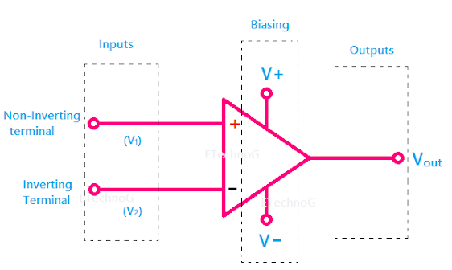
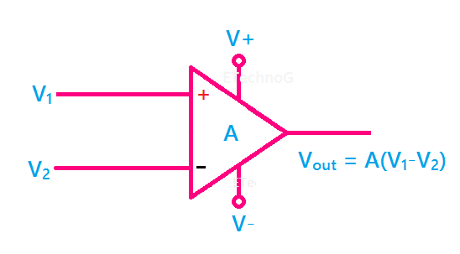
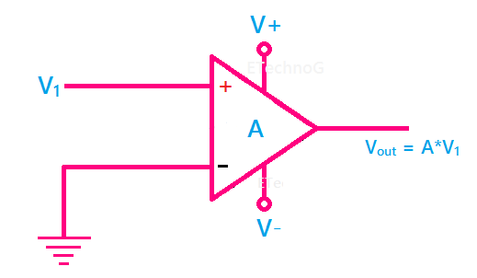
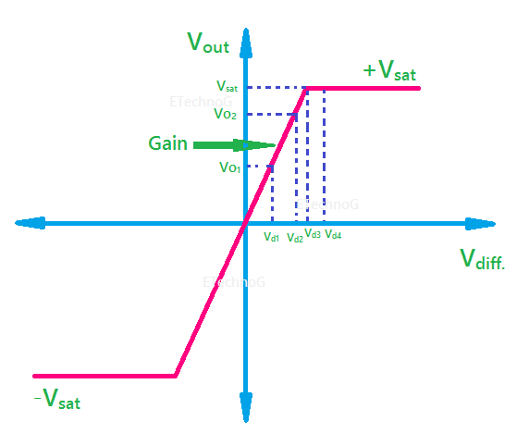
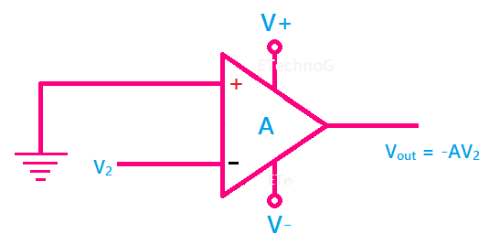
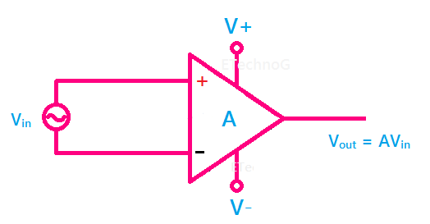
Operational Amplifier
Circuit symbol of the operational amplifier:
2 input and 1 output
Most of the operational amplifiers consist of two power supplies( positive and negative power supply)
Vout = A(V1-V2)
Vout = A.V1
Value of gain is used in range of 10⁵ to 10⁶. Example Vin = 1mV so Vout = 1m x 10⁵ = 100V.
Vout = A.V2
Vout = A.Vin (high gain)
Page: 02

Slide 5
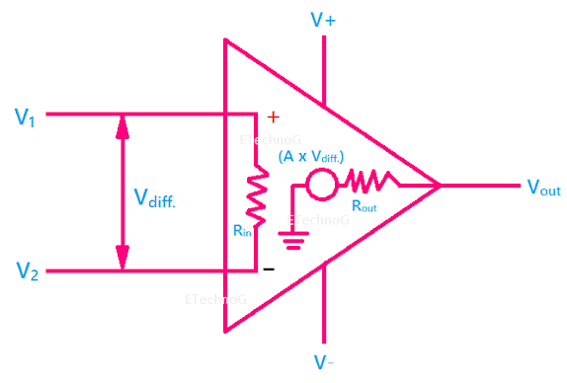
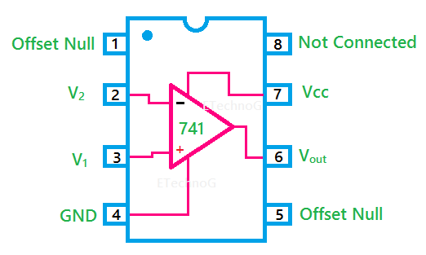
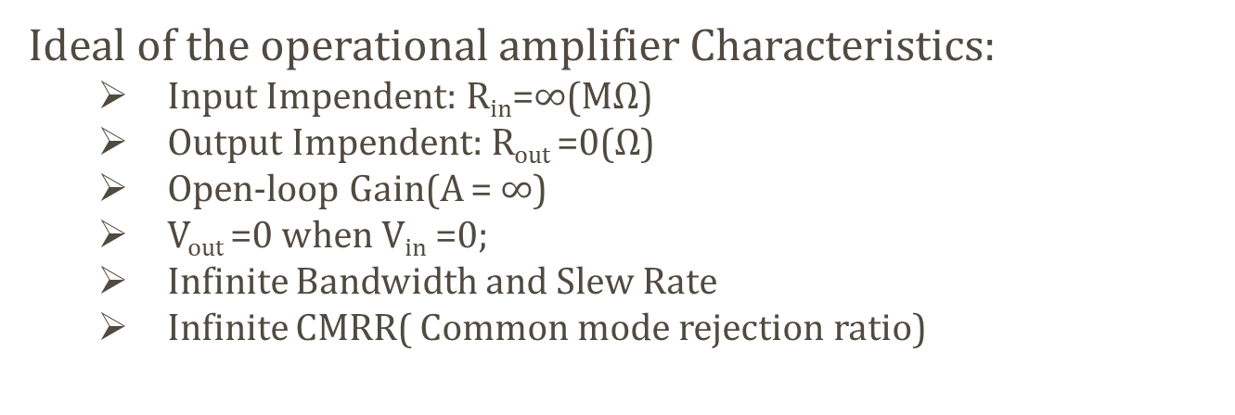
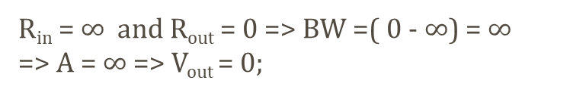
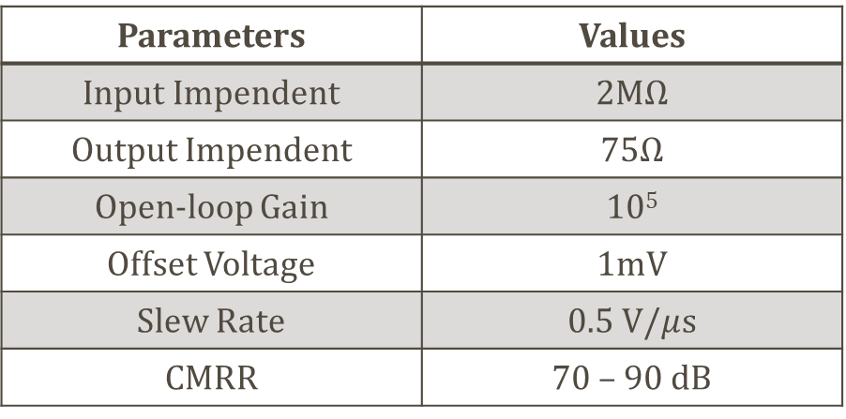
Operational Amplifier
Ideal of the operational amplifier Characteristics:
Input Impendent: R_{in}=$∞$(M$Ω$)
Output Impendent: R_{out} =0($Ω$)
Open-loop Gain(A = $∞$)
V_{out} =0 when V_{in} =0;
Infinite Bandwidth and Slew Rate
Infinite CMRR( Common mode rejection ratio)
R_{in} = $∞$ and R_{out} = 0 => BW =( 0 - $∞$) = $∞$
=> A = $∞$ => V_{out} = 0;
OP-AMP 741 Specification
Parameters | Values
Input Impendent | 2M$Ω$
Output Impendent | 75$Ω$
Open-loop Gain | 10⁵
Offset Voltage | 1mV
Slew Rate | 0.5 V/$μ$s
CMRR | 70 – 90 dB
Page: 03

Slide 6
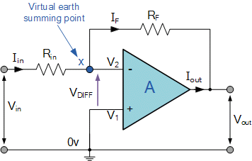
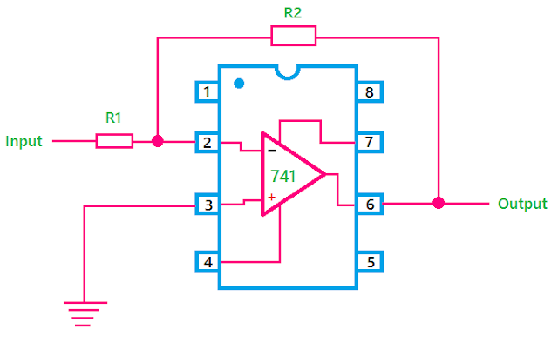
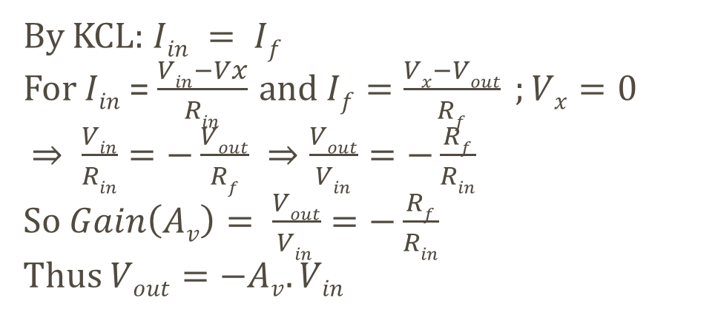
Inverting OP-Amp
By KCL: $Iin = If$
For $Iin$= $\frac{Vin−Vx}{Rin}$ and $If=\frac{Vx−Vout}{Rf} ;Vx=0$
$⇒ \frac{Vin}{Rin}=−\frac{Vout}{Rf} ⇒\frac{Vout}{Vin}=−\frac{Rf}{Rin}$
So $Gain\left(Av\right)= \frac{Vout}{Vin }=−\frac{Rf}{Rin}$
Thus $Vout=−Av.Vin$
Example: R_{in} = R_{f} = 1k
And V_{in} = 2V => A_{v} = -1 => V_{out} =-2V
Page: 04

Slide 7
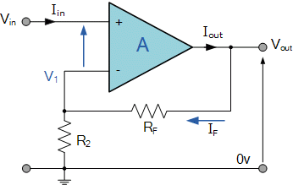
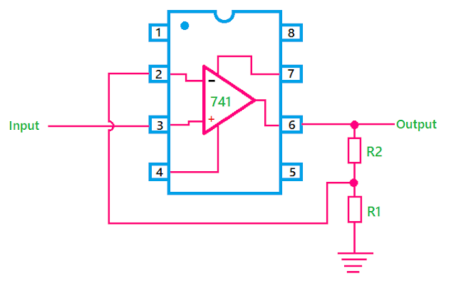
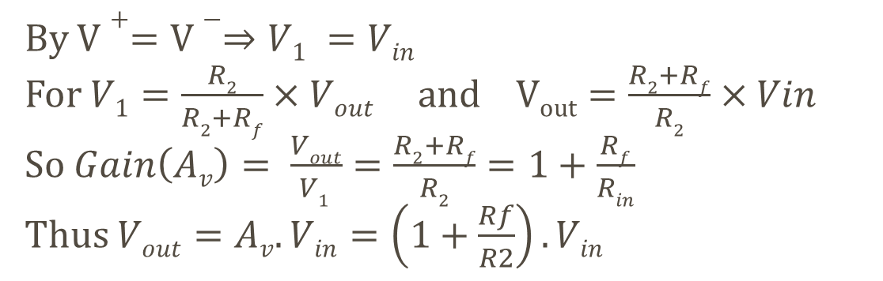
Non-Inverting OP-Amp
By $V+=V−⇒V1 =Vin$
For $V1=\frac{R2}{R2+Rf}×Vout$ and $Vout=\frac{R2+Rf}{R2}×Vin$
So $Gain\left(Av\right)= \frac{Vout}{V1 }=\frac{R2+Rf}{R2}=1+\frac{Rf}{Rin}$
Thus $Vout=Av.Vin=\left(1+\frac{Rf}{R2}\right).Vin$
Example: R₂ = R_{f} = 1k
And V_{in} = 2V => A_{v} = 2 => V_{out} =4V
Page: 05

Slide 8
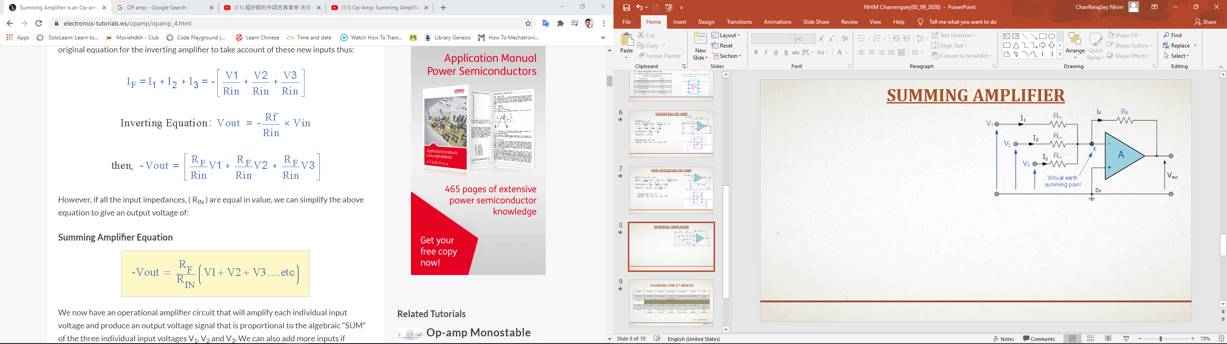
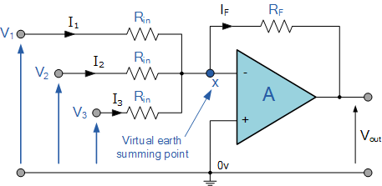
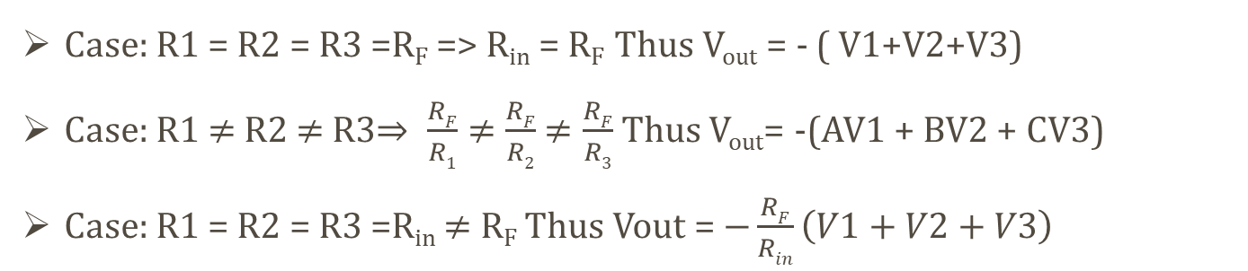

Summing Amplifier(Inverting Op-Amp)
By KCL:
$$\frac{Vout}{Rf} =If$$
Case: R1 = R2 = R3 =R_{F} => R_{in} = R_{F} Thus V_{out} = - ( V1+V2+V3)
Case: R1 $≠$ R2 $≠$ R3$⇒ \frac{RF}{R1}≠$ $\frac{RF}{R2}$ $≠\frac{RF}{R3}$ Thus V_{out}= -(AV1 + BV2 + CV3)
Case: R1 = R2 = R3 =R_{in} $≠$ R_{F} Thus Vout = $−\frac{RF}{Rin}\left(V1+V2+V3\right)$
Page: 06

Slide 9
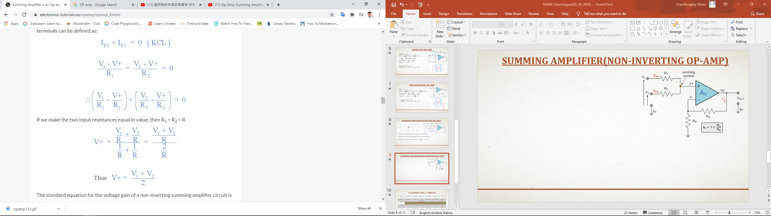
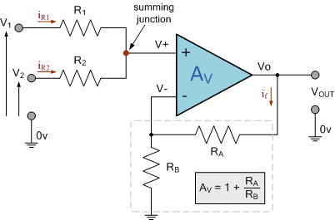
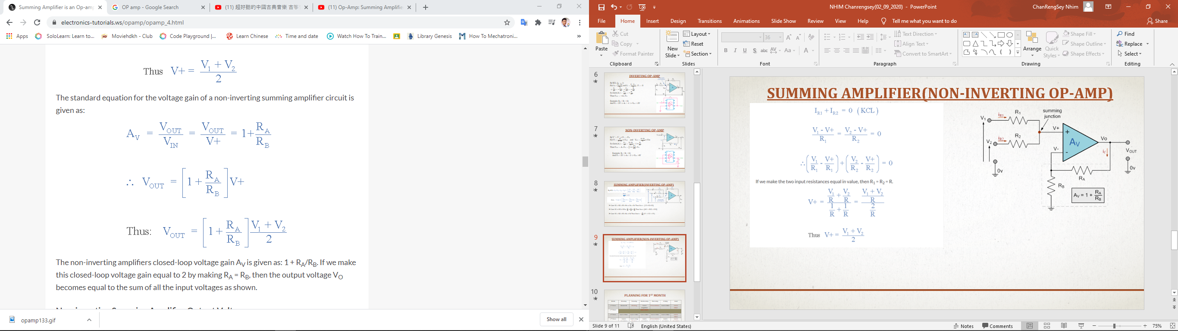
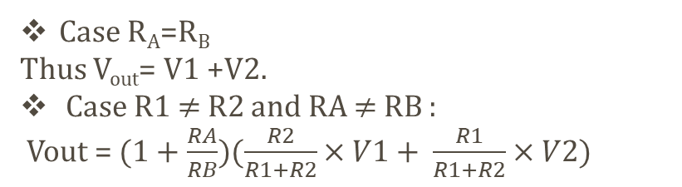
Summing Amplifier(Non-Inverting Op-Amp)
Case R_{A}=R_{B}
Thus V_{out}= V1 +V2.
Case R1 $≠$ R2 and RA $≠$ RB :
Vout = $(1+\frac{RA}{RB})(\frac{R2}{R1+R2}×V1+ \frac{R1}{R1+R2}×V2)$
Page: 07

Slide 10
Difficulty and Missing
Difficulty :
Many resource to read and learn
Don’t have enough time.
Missing:
Lately work
Page: 08

Slide 11
Planning for 1st month
Week | Monday | Tuesday | Wednesday | Thursday | Friday | Goal
1st Week | Research | Meeting | Learn Amplifier | Presentation | Learn Filter | Learn Filter
2nd Week |  |  | REST DAYS
3rd Week | Learn Filter | Learn Filter | Learn Filter | Learn Filter | Learn Filter | Learn Filter
4th Week | Learn Amplifier | Learn Amp Meeting | Learn Amplifier | Presentation Learn Amp | Learn Amplifier | Learn Amplifier
Start : 10/08/2020
Page: 09

Slide 12
Planning for 2nd month
Week | Monday | Tuesday | Wednesday | Thursday | Friday | Goal
5th Week | Build Filter pH & LCD | Meeting Build Filter | Filter Build filter | Presentation Build Amp | Build Amplifier | Design Amplifier
6th Week | Build Amplifier | Meeting Learn stm32 | Learn STM32 Test LCD/pH | Presentation Write Code | Write Code STM32 | Start STM32
7th Week | Write Code STM32 | Meeting Write Code | Write Code STM32 | Presentation Write code | Finish STM32 Code | Finish STM32 Code
8th Week | Draw case for hardware | Meeting Draw case | Draw case for hardware | Presentation Draw case | Print 3D case | Build case Finish Job
Start : 06/09/2020
Page: 10

Slide 13
THANK YOU

